Slide 1
Clause-Activation Signatures (CAS)
A short, signed, checkable evidence list per attack family - pulled out of a Tsetlin Machine's 2,400 rules
Rakesh Reddy Yakkati et al. · method walkthrough · CICIoMT2024
Notes:
One sentence: a Tsetlin Machine already gives us human-readable rules, but far too many of them. CAS is a procedure that keeps only the rules that behave like real evidence for an attack family, labels each one 'for' or 'against', and attaches a number saying how many could still be noise.

Slide 2
MOTIVATION
2,400 rules - which ones are real evidence?
Trained Tsetlin Machine
CAS
keep only the rules re-selected
as evidence again and again,
then label each FOR / AGAINST
6 families x 400 clauses = 2,400 rules
most fire by chance or duplicate · a few truly mark an attack
NOTE: CAS does not retrain or change the TM. It reads a frozen model and distils its rules - the base detector is untouched.
Notes:
The TM learns 400 if-then rules per family, six families, so 2,400 rules in one model. Example rule on screen. The trouble: on any given run many of these fire by luck or just repeat each other. If a forensic analyst asks 'why did you call this DDoS', we cannot hand over 2,400 rules. So the question CAS answers is: which rules are stable, real evidence - and are they evidence for the family or against it.

Slide 3
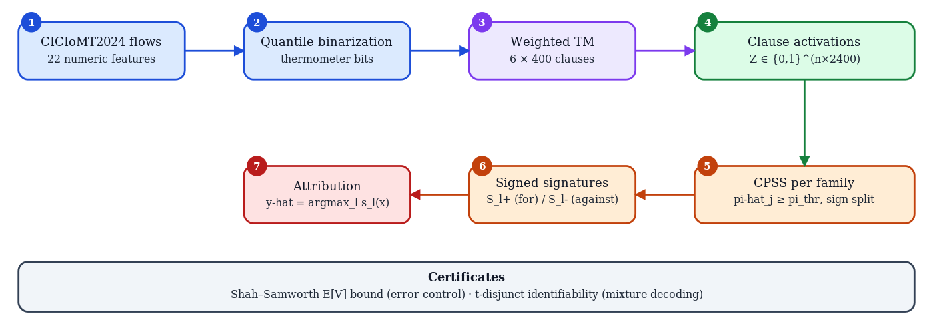
OVERVIEW
The pipeline
frozen TM -> which clauses fire -> keep the stable ones -> split FOR / AGAINST -> score each family, highest wins
Notes:
Whole method in one picture. Left to right: take CICIoMT2024 flows, turn each number into threshold bits, train the weighted TM, read off which clauses fire. Then the CAS part: stability-select per family, split by sign, and score. The grey box at the bottom is the two guarantees we can prove about the result. Next slides walk the four CAS steps.

Slide 4
STEP 1 OF 4
Clause activations - a flow becomes the rules it triggers
frozen TM
clause 12
clause 42
Z row for x (2,400 bits)
network
flow x
0
1
0
0
1
0
1
0
0
0
1
0
clause 72
clause 102
1 = that rule matched x
clause 132
clause 162
From here on we work only with these bits - a flow = which known rules it matches.
Notes:
Step 1 is just a change of representation. Push every flow through the already-trained TM and record, for each clause, 1 if it fired and 0 if not. So a flow stops being 22 numbers and becomes 2,400 yes/no answers - 'which of my known rules match this flow'. Everything after this works on those bits, which is what makes the output readable.

Slide 5
STEP 2 OF 4
Stability voting (CPSS) - keep rules that keep getting picked
0.97
0.92
one round: split into 2 complementary halves
0.90
0.85
0.83
half A
L1-logistic fit
(sweep 6 penalties)
π_thr = 0.8
flows as
Z rows
(Step 1)
0.55
0.37
0.30
half B
L1-logistic fit
(sweep 6 penalties)
0.20
clauses
π_j = (half-fits that picked clause j) / 2B
× B rounds → 2B half-fits
each fit's features = the 2,400 clause bits (not raw features)
Signature of a family = every clause with π_j ≥ 0.8 (green bars). One lucky fit can't get in.
Notes:
Step 2 is the core. For one family versus all the rest: take the flows - each flow is its 2,400 clause bits from Step 1, not the raw features - split them into two complementary halves, fit a sparse logistic model on each half. The model's inputs are the clause bits, so 'sparse' means it is forced to pick only a handful of clauses. Each fit actually tries six penalty strengths and we count a clause if it survives any of them. Do this for B rounds, two halves per round, so 2B fits total - not B. pi-hat for a clause is the fraction of those 2B fits that picked it. Keep a clause only if pi-hat is at least 0.8 - picked almost every time. A clause that only showed up in a lucky fit is gone. We use 0.8 not 0.6 because at 0.6 the kept set wobbles run to run.

Slide 6
STEP 3 OF 4
Sign split - evidence FOR vs. evidence AGAINST
S+ evidence FOR DDoS (mean weight > 0)
kept clauses (DDoS)
c1 Rate≥bin4
c1 Rate≥bin4 +2.1
c3 SYN set +1.7
c8 many dst +0.9
c3 SYN set
a flow triggering these looks like DDoS
c8 many dst
c4 idle gaps
S- evidence AGAINST DDoS (mean weight < 0)
c9 short pkts
c4 idle gaps -1.4
c9 short pkts -0.8
these are benign habits - firing them argues DDoS is NOT the answer
Why: stability selection picks useful clauses in BOTH directions. Ignoring the sign scored 0.004 F1 - below random.
Notes:
Being stably selected tells us a clause matters, not which direction. Some kept clauses have a positive weight - they fire on the family, that's evidence for. Some have a negative weight - they fire on everything except the family, that's a benign habit, evidence against. We average the sign over all the fits and split the signature into S-plus and S-minus. This matters a lot: when we skipped it and treated every clause as support, the score was 0.004 F1, worse than a coin flip.

Slide 7
STEP 4 OF 4
Attribution score - which family does a new flow match?
clauses of family L that fire on x
0.91
S+ c1 +0.97
S+ c3 +0.90
0.72
new
flow x
S+ c8 +0.85
S- c4 -0.87
0.55
0.40
0.34
(Σ S+ fired - Σ S- fired)
÷ Σ all S+ weight
0.28
Ben
DDoS
DoS
MQTT
Recon
Spf
highest score -> attributed family = DDoS
÷ by Σ S+ weight so a big signature gets no free advantage - the score is 'what fraction of possible evidence fired'.
π as weight a clause kept in 97% of refits counts more than one kept in 80% - no new knob.
Notes:
Step 4 scores a new flow against each family. Add the pi-hat of every 'for' clause that fires, subtract the pi-hat of every 'against' clause that fires, then divide by the total 'for' weight. The pi-hat is the weight, so a clause kept 97% of the time counts more than one kept 80% - no extra parameter. Dividing by the total is important: without it a family with more clauses always wins just for being bigger. With it, the score means 'what fraction of the possible evidence actually showed up'. Highest score across the six families is the answer.

Slide 8
PUTTING IT TOGETHER
Worked example - scoring two flows for DDoS
DDoS signature: S+ c1 (0.97), c3 (0.90) S- c4 (0.87) Σ S+ weight = 1.87
flow x
fires c1, c3
not c4
c1 +0.97
(0.97 + 0.90 − 0) / 1.87
= 1.00
strong match
c3 +0.90
flow y
fires c4 only
(0 − 0.87) / 1.87
= −0.47
argues against
c4 −0.87
Repeat for all 6 families -> highest score wins. Its S+ / S- clauses are the analyst's evidence list.
Notes:
Concrete run-through for DDoS. Its signature after steps 2 and 3: two 'for' clauses, c1 and c3, and one 'against' clause, c4. Total 'for' weight 1.87. Flow x fires both 'for' clauses and not c4: score is 1.87 over 1.87 equals 1.0, a clean match. Flow y fires only the 'against' clause: minus 0.87 over 1.87 equals minus 0.47, actively arguing this is not DDoS. Do the same for all six families and take the top score.

Slide 9
WHY TRUST IT
Each signature ships with an error bound
Benign signature - 216 clauses kept:
≥ 51 trustworthy
≤ 165 may be spurious (Shah–Samworth E[V] bound)
Where the bound comes from
straight out of Step 2's re-selection
fractions - no extra assumptions.
We report it loose where it is loose.
Identifiability
the 6 signatures are 5-disjunct:
any mix of up to 5 families is still
exactly decodable from the union.
The attribution score uses only the tighter ~40-clause S+ part of each signature.
Notes:
Why a reviewer should believe the list. The Shah-Samworth bound gives a number, E of V, for how many kept clauses could be spurious. For Benign, 216 kept, bound says at most 165 could be noise - so at least 51 are solid. The bound is loose and we say so. It falls straight out of the re-selection fractions from step 2, no extra assumptions. Second guarantee is identifiability: even though the six signatures overlap, any mixture of up to five families can still be decoded uniquely - they form a 5-disjunct code.

Slide 10
BOTTOM LINE
Delivers - and where it does not
family attribution (macro-F1)
binary attack detection (AUROC)
0.94
0.77
0.82
0.69
base TM
CAS
base TM
CAS
also: ~39–47 clauses per family (of 2,400) · seed-reproducible · each list carries its E[V] bound
Honest limits
• weak at flagging a genuinely NEW family (false-alarm control holds, detection power is low)
• clause identities don't line up across retraining - same-model stability only, for now
• gains need a base detector with slack; on a near-perfect base, CAS is lossy compression
Notes:
Bottom line. On family attribution CAS goes from 0.69 to 0.77 macro-F1 over the base TM, three seeds. Collapsed to just attack-versus-normal, AUROC 0.82 to 0.94. And it does this with about 40 clauses per family out of 2,400, every number reproducible, each list carrying its bound. The honest limits: it's weak at spotting a brand-new attack family it never trained on, the specific clause identities don't survive retraining, and the whole thing only helps when the base detector had room to improve.

